Slide 1


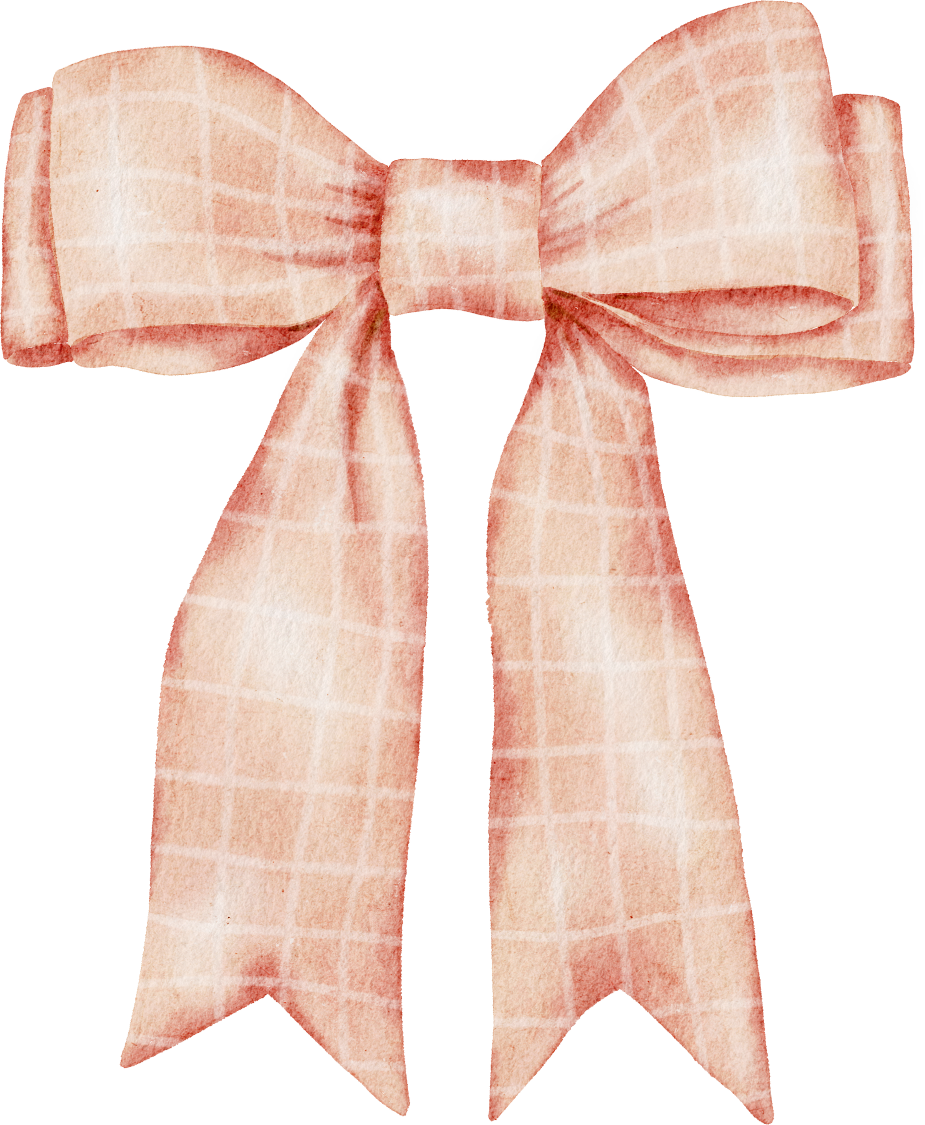

WELCOME TO
Olivia's
Bridal Shower

